Slide 1
Statiscal Analysis of Marino Center Operations & Maintainence

Slide 2
Supervised by Prof. Rajesh Jugulum
Presented by:
Deep Vaghani
Preet Parmar
Sahil Shah
Sonam Malhotra

Slide 3
INTRODUCTION
Our project emphasize on the operations and maintainence of Northeastern’s Marino center. It scrutinize the day- to- day functions performed in marino center which includes quantity of people per day, quality of equipment and facility infrastructure. By performing Hypothesis testing, we calculate the parametric statistics for the daily capacity of unit. Also it accentuate the learning of statistics and tools used in the process
AIM:
To examine the constarints of Marino Center infrastructure
OBJECTIVES:
To provide the statistical analysis of the Marino center’s daily operation keeping a fixed mean as 4500 and examine the efficiency at max. capacity to analyse the requirement for any future development.

Slide 4
Marino Center Operation
The Campus Recreation Program provides many outlets to help clear your mind and recharge your spirit. Marino’s fitness facilities, unique among Boston area Colleges & Universities, are open year round
1

Slide 5

WORK FLOW
Data Collection
Performing Tests
Collecting sample data
Hyoithesis and various tests are performed on the collected data.
DATA COLLECTION
TESTS
Improvement
Conclusion
Various steps are taken in order to improve the efficiency.
IMPROVEMENT
CONCLUSION
We draw a conclusion based on the results from the test performed in the earlier stage.

Slide 6
P-DIAGRAM
Number of Equipment
Non University members
Holidays
Timings
Controllable Factors
Number of Students
MARINO CENTER OPTIMIZATION
Providing effective training opportunities
Uncontrollable Factor
Number of People
Failure of Equipment
External Factors
Uncontrollable Factors

Slide 7
Time Series Plot
As we can see from the graph, Number of people with respect to the data collected from last 3 months shows that the Marino center is not fully utilized as per the capacity and detrimenting in later stages which can be related to the noise factors such as Facility distribution,equipment distribution or external factors

Slide 8
Hypothesis Testing
A hypothesis test is a statistical test that is used to determine whether there is enough evidence in a sample of data to infer that a certain condition is true for the entire population.
Based on the sample data, it determines whether to reject the null hypothesis which in this case is mean=4500

Slide 9
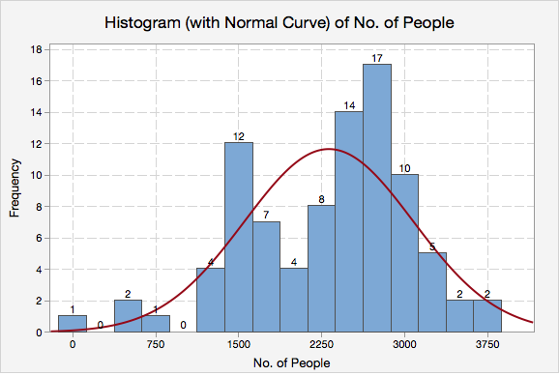
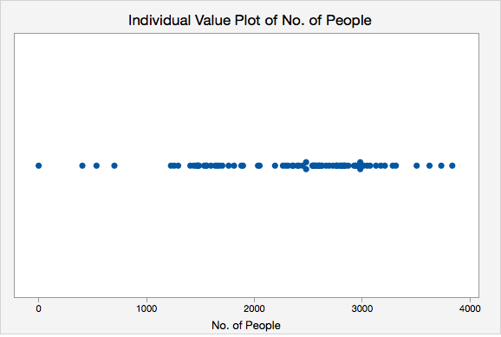
DESCRIPTIVE ANALYSIS OF PEOPLE USING MARINO CENTER

Slide 10
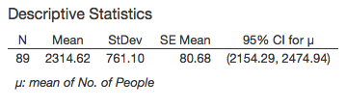
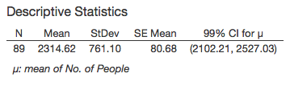

Hypothesis Data
1. Specifying the hypotheses
H0: µ = 4500
H1: µ ≠ 4500
2. Determining the power and Sample Size which in this case is 89
3. Choosing the significance level(CI)
4. Collecting the data
5. Comparing the P-Value
6. Decision to fail or fail to reject null hypothesis

Slide 11
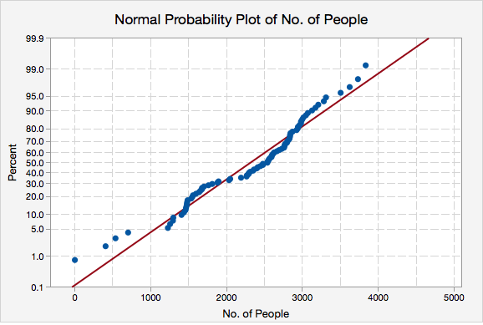
Anderson Darling Test
It will measure how well the data follows the normal distribution as it is substantially lower than other distribution.

Slide 12

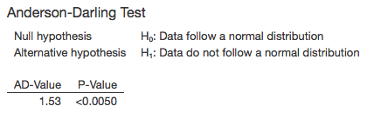
We performed the Anderson-Darling Normality test, from the Histogram and Probability Plot; we conclude that production statistics of PEOPLE USING MARINO CENTER is normally distributed.

Slide 13
HYPOTHESIS ANALYSIS:
We performed the T test for the hypothesis testing on people using MARINO center for keeping their body fit and healthy. We took the mean µ as the daily maximum capacity of MARINO Center which is 4500 people.
H₀: µ = 4500
H₁: µ ≠ 4500
VARIABLE | N | Mean | St.DEv | SE Mean | 95% CI | T-Value | P Value
MARINO | 89 | 2314.62 | 761.10 | 80.68 | (2154.29,2474.94) | -27.09 | <0.0001

Slide 14
Conclusion
OUTCOME:
From the Hypothesis we can observe that the p-value is <0.0001 which is less than α=0.05 also after finding the tabulated value for t which equals 27.09, we can see that the calculated is larger than the tabulated, so we reject the null hypothesis. From this we can conclude that MARINO Center is not working as per its capacity. Since the mean and the upper bound of the 95% CI are 2154.29 and 2474.94 people range, we can state that the Marino Center is not fully optimized by the people and improvements are needed in some specific areas so that it can be fully optimized.
RESULT:
From the hypothesis testing we reject the null hypothesis µ = 4500 people and accept the alternative hypothesis µ ≠ 4500. Also we can observe from the test that sample mean is significantly lower that the tested mean, which states that Marino center is not working at its full capacity and need to focus on some areas to optimize it fully.

Slide 15

SCOPE OF IMPROVEMENT

Slide 16
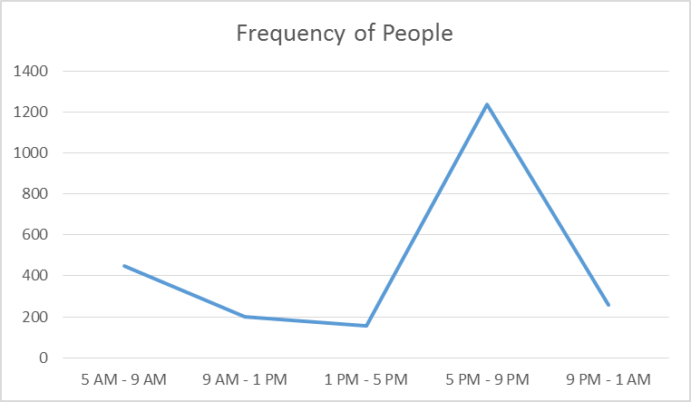
Analyzing the graphs

Slide 17
One Graph is Worth a Thousand logs
This graph shows the relationship (In percentages) between the equipments and population using the same keeping other factors as constant.
.

Slide 18
THANKS!
There are two kinds of Statistics: the kind you “Look Up” and the kind you “Make Up”
Rex Stout
Any questions?

